Slide 1
Optimization

Slide 2
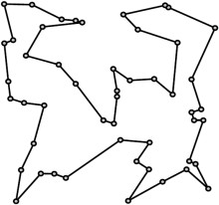
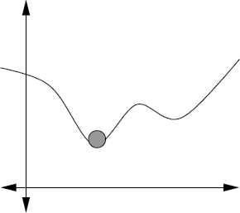
Optimization
Find the best solution (i.e., of minimum or maximum value) from a set of alternatives.
Solving and optimizing not much different: for example, to solve f(x) = 0, minimize |f(x)|².
Regression is the process of fitting parameters to a model to minimize its error when fitting to data.
Linear regression
The traveling salesman problem (TSP)
Function minimization
Happiness
Knowledge of algorithms

Slide 3
Iterative Refinement
Simple yet powerful idea:
Start with some arbitrary feasible solution (or better yet, a solution obtained via some other heuristic)
As long as we can improve it, keep making it better (e.g., search a small “neighborhood” of solutions similar to x, moving to better one if found)
Simple example: bubble sort.
Getting stuck in local minima can be a problem.
Many approaches refine a population of solutions, rather than a single solution.

Slide 4




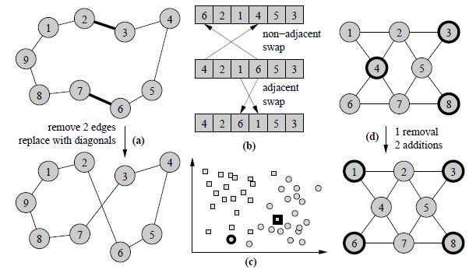


Local Search – Neighborhood Examples
Traveling salesman:
Rank aggregation:
Max independent set:
Max
indep
end
ent
Max
inde
pen
dent
Neighborhood size? (large vs. small)
Movement strategy? (immediate vs. after searching entire neighborhood)
Balanced clustering

Slide 5
Population-Based Search: Genetic Algorithms
Start with a population of initial solutions.
Each member of next generation obtained by:
Mutation of good solution from previous generation,
Result of “mating” together two good solutions from previous generation, or
Direct copy of best solution from previous generation.
Solutions from previous generation chosen
with probability related to their fitness.
Sometimes called “roulette wheel” selection.

Slide 6
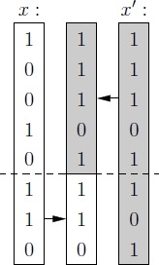
Genetic Algorithms: “Crossover” for Combining Solutions…

Slide 7
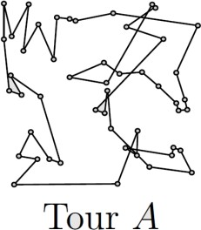
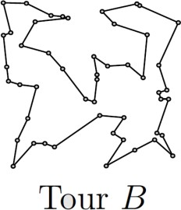
Genetic Algorithms: “Crossover” for Combining Solutions…
?

Slide 8
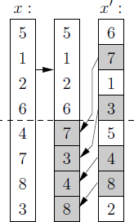
Genetic Algorithms: “Crossover” for Combining Solutions…
?

Slide 9
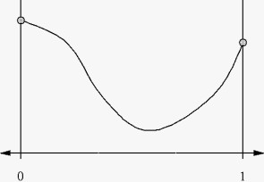
Unconstrained Optimization
of F(x) Based On Iterative Refinement
To refine a guess x, locally approximate F at x using either a linear function or a quadratic.
x
Gradient Descent (if derivatives easy to compute)
Careful with step size
Many fast “low quality” steps
x
Newton’s Method (if second derivatives easy to compute)
- Fewer slow “high quality” steps (in N dimensions, each step involves solving an N-variable linear system).
Convex functions nice, since local optimal point is also a global optimum point.

Slide 10
Unconstrained Optimization
of F(x) Based On Iterative Refinement
To refine a guess x, locally approximate F at x using either a linear function or a quadratic.
x
Gradient Descent (if derivatives easy to compute)
Careful with step size
Many fast “low quality” steps
x
Newton’s Method (if second derivatives easy to compute)
- Fewer slow “high quality” steps (in N dimensions, each step involves solving an N-variable linear system).
What if computing derivatives at all isn’t easy…?

Slide 11
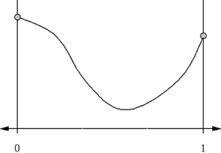
If Derivatives are Hard to Compute…
The Nelder-Mead algorithm (also called simplex search or “amoeba” search).
F(y) = 7
F(x) = 10
x
y
F(z) = 6
In d dimensions, “bracket” solution with d+1 points
Move “bracket” with worst function value in direction of others

Slide 12
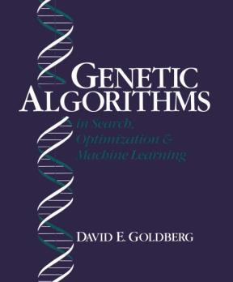













Physical and Biologically Inspired Computing Paradigms
Simulated Annealing
Genetic/Evolutionary Algorithms
Bio-Inspired Optimization Methods
Neural Networks
Artificial Immune Systems

Slide 13
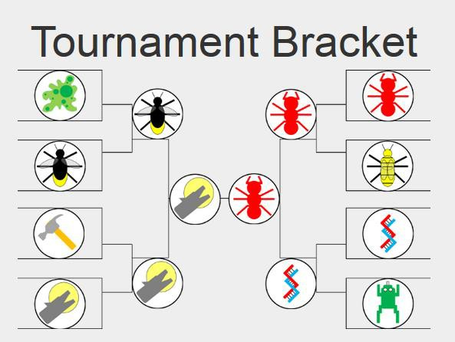
Physical and Biologically Inspired Computing Paradigms
17

Slide 14
Linear Systems
N unknown variables, N equations
(what if # of variables is more or less than the # of equations?)
Example: | x + y = 3
 | 2x – y = 3
Example: | x₁ + 2x₂ + 3x₃ 4x₁ + 5x₂ + 6x₃ 7x₁ + 8x₂ + 9x₃ | = 10 = 11 = 12
We often write these using matrix-vector notation:
1 2 3 𝑥1 10
4 5 6 𝑥2 ₌ 11
7 8 9 𝑥3 12
𝐴 𝑥 𝑏

Slide 15
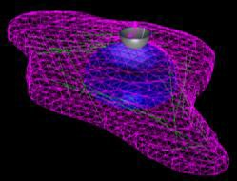
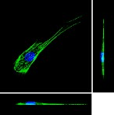
Linear Systems are Everywhere
Least squares regression or solving a system of equations usually involves minimizing a quadratic function giving squared error.
To minimize a quadratic, set its gradient to zero – this gives a linear system!
Newton’s method
Linear regression
Happiness
x
Numerical solution of a large system of equations in scientific computing
Knowledge of algorithms

Slide 16
Solving Linear Systems with Gaussian Elimination
Consider solving an N x N linear system Ax = b.
Example:
x₁ + 2x₂ + 3x₃ = 10 4x₁ + 5x₂ + 6x₃ = 11
7x₁ + 8x₂ + 9x₃ = 12
Solve first equation for x₁ in terms of other variables: x₁ = 10 – 2x₂ – 3x₃.
Plug this in to eliminate x₁ from equations 2…N, giving a system of N – 1 variables, N – 1 equations.
Eventually, we get a single equation in x_{N}. Solve it, then work backwards to get values of x_{N-1} … x₁.
Total running time: O(N³)

Slide 17
Solving Linear Systems with Gaussian Elimination
The “standard” method for solving a linear system via Gaussian elimination takes O(N³) time.
With a bit of cleverness, we can solve a linear system in the same amount of time it takes to multiply two N x N matrices (also O(N³) time using the most straightforward approach).
However, matrix multiplication can be done a bit faster…

Slide 18
Solving Linear Systems with Gaussian Elimination
The “standard” method for solving a linear system via Gaussian elimination takes O(N³) time.
With a bit of cleverness, we can solve a linear system in the same amount of time it takes to multiply two N x N matrices (also O(N³) time using the most straightforward approach).
However, matrix multiplication can be done a bit faster…
Matrix Multiplication…
Best known lower bound: Ω(n²) (trivial)
Strassen 1969: O(n^{2.81})
Coppersmith and Winograd 1990: O(n^{2.376})
(However, it’s quite complicated and not very
practical)
Stothers 2011: O(n^{2.374})
Williams 2012: O(n^{2.3729})
Le Gall 2014: O(n^{2.37287})

Slide 19
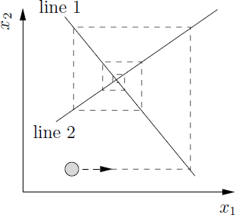
Solving Linear Systems (Potentially
Faster) with Iterative Refinement
Consider solving an N x N linear system Ax = b.
Example:
x₁ + 2x₂ + 3x₃ = 10 4x₁ + 5x₂ + 6x₃ = 11
7x₁ + 8x₂ + 9x₃ = 12
A faster solution (applicable to many common linear systems) uses iterative refinement:
Guess an initial solution x = (x₁…x_{N})
Solve equation 1 for x₁ to update x₁.
Solve equation 2 for x₂ to update x₂.
Etc…
Repeating until convergence.

Slide 20
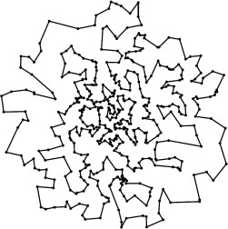
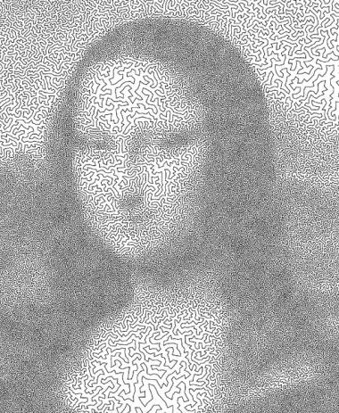

Traveling Salesman is a “Hard” Problem; What Does this Mean…?

Slide 21

Aside: A Brief Introduction to the
Theory of Computation
What is a computer?

Slide 22
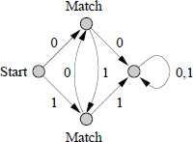
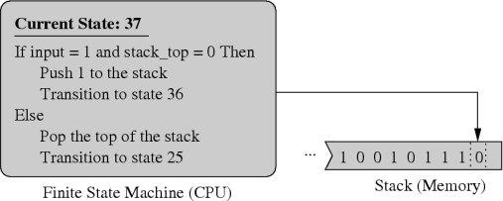
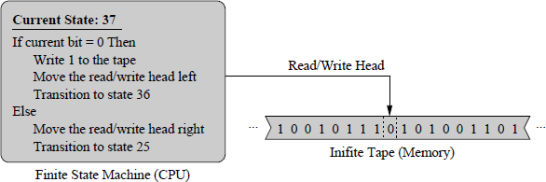
Different Models of Computing
Machines
Finite-state automaton (recognizes binary strings of the form (0(10)*)|(1(01)*))
Push-down automaton
Turing machine

Slide 23
Different Models of Computing
Machines
Simple models of computation:
Finite state automata
Pushdown automata
Turing machines
“Non-regular” problems cannot be solved by FSAs, but
these might be solvable with PDAs.
“Non-context-free” problems cannot be solved by PDAs, but these might be solvable with a Turing machine.
“Undecidable” problems cannot be solved by Turing machines, and according to Alan Turing, these cannot be solved on any computing machine!
Alan Turing (1930s): no computing machine is more powerful than a Turing machine in terms of the set of problems it can solve.
The halting problem is a famous undecidable problem.

Slide 24
From Computability to
Complexity Theory
Turing’s work helped define what problems can and cannot be solved by algorithms.
The next question is what problems can be solved efficiently by algorithms in various models of computation.
Edmonds (1960s): “Efficiently” = “in polynomial runing time”. I.e., O(n²) or O(n³), not O(2^{n}).
One of our main jobs as algorithm designers is to figure out if problems can be solved efficiently…

Slide 25
Bad News: NP-Hard Problems
The traveling salesman problem belongs to a large class of problems called NP-Hard problems.
We strongly suspect these problems cannot be solved efficiently (in polynomial time).
An efficient solution to just one single NP-hard problem would imply an efficient solution to all of them, since they are all related via efficient “reductions” from one problem to another.
However, nobody has been able to prove this yet, and it’s probably the most famous open problem in all of computer science!

Slide 26
Bad News: NP-Hard Problems
The traveling salesman problem belongs to a large class of problems called NP-Hard problems.
Since we don’t know how to solve TSP or other NP-hard problems efficiently, we often use heuristics like iterative refinement or genetic algorithms that deliver “reasonably good” solutions…
For Lab 11, you will try to get the best possible solution to a small instance of TSP with 14 cities, using iterative refinement.

